Slide 1
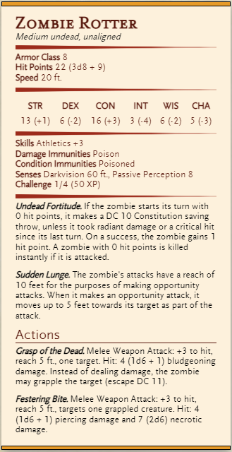
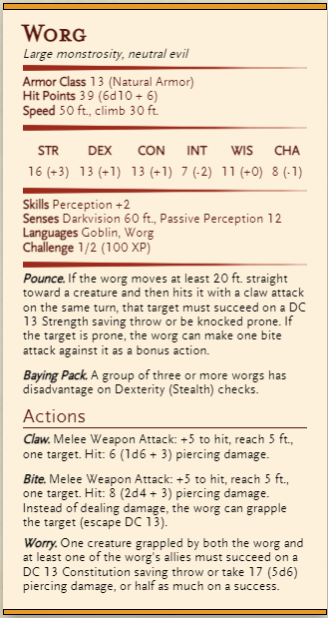
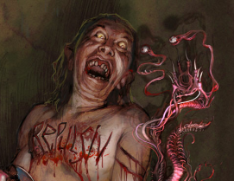
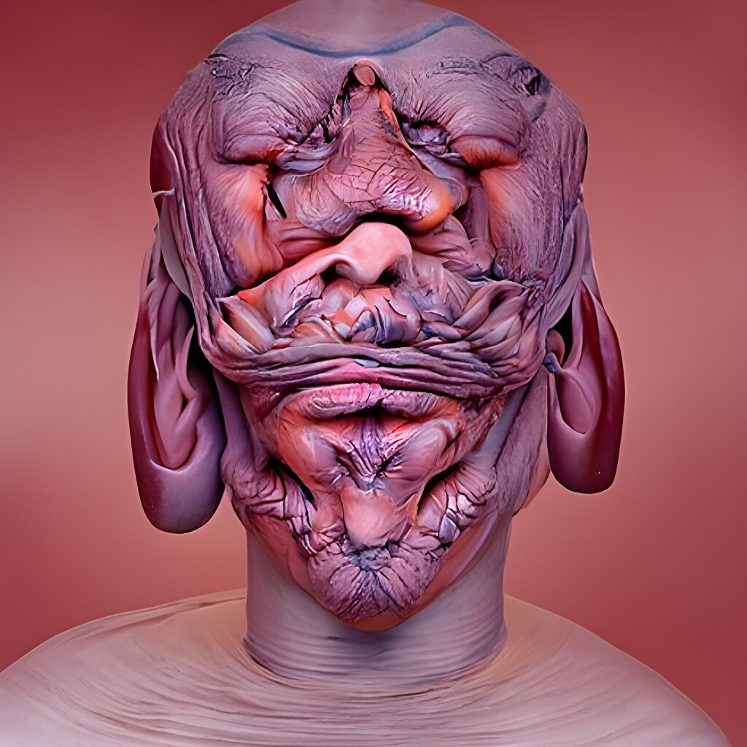
Notes:
Generel Kannibal, alle undead

Slide 2
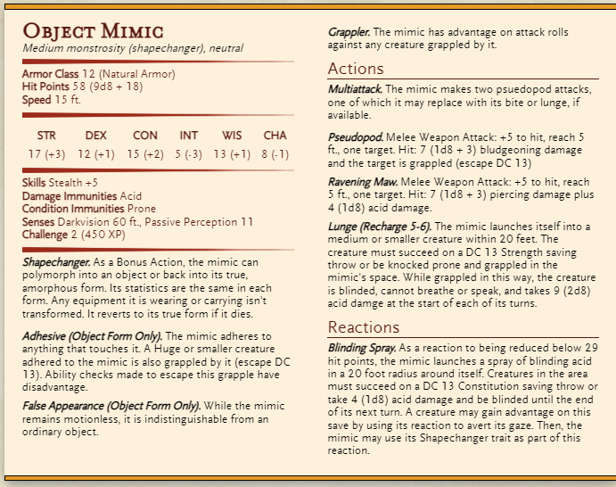
Notes:
Tyngdekammeret

Slide 3
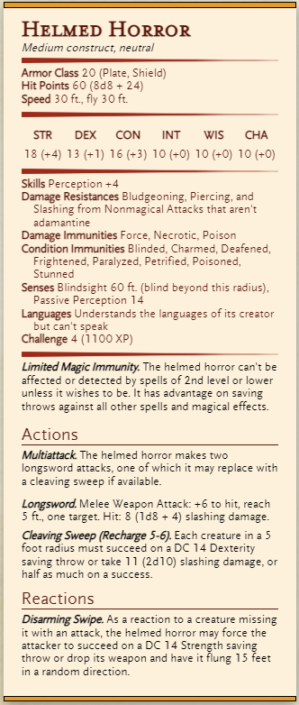
Notes:
Tyngderummet, dværge statue

Slide 4
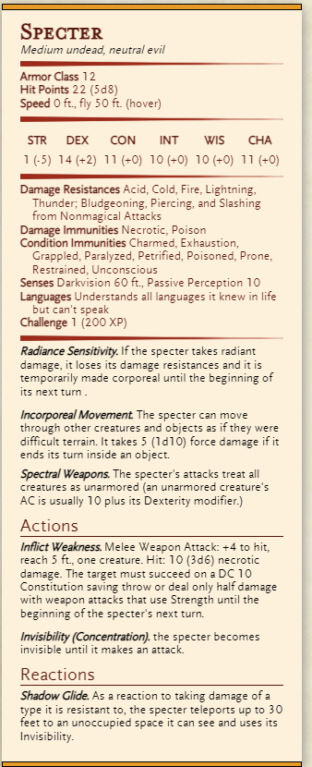
Notes:
Skattekammeret

Slide 5
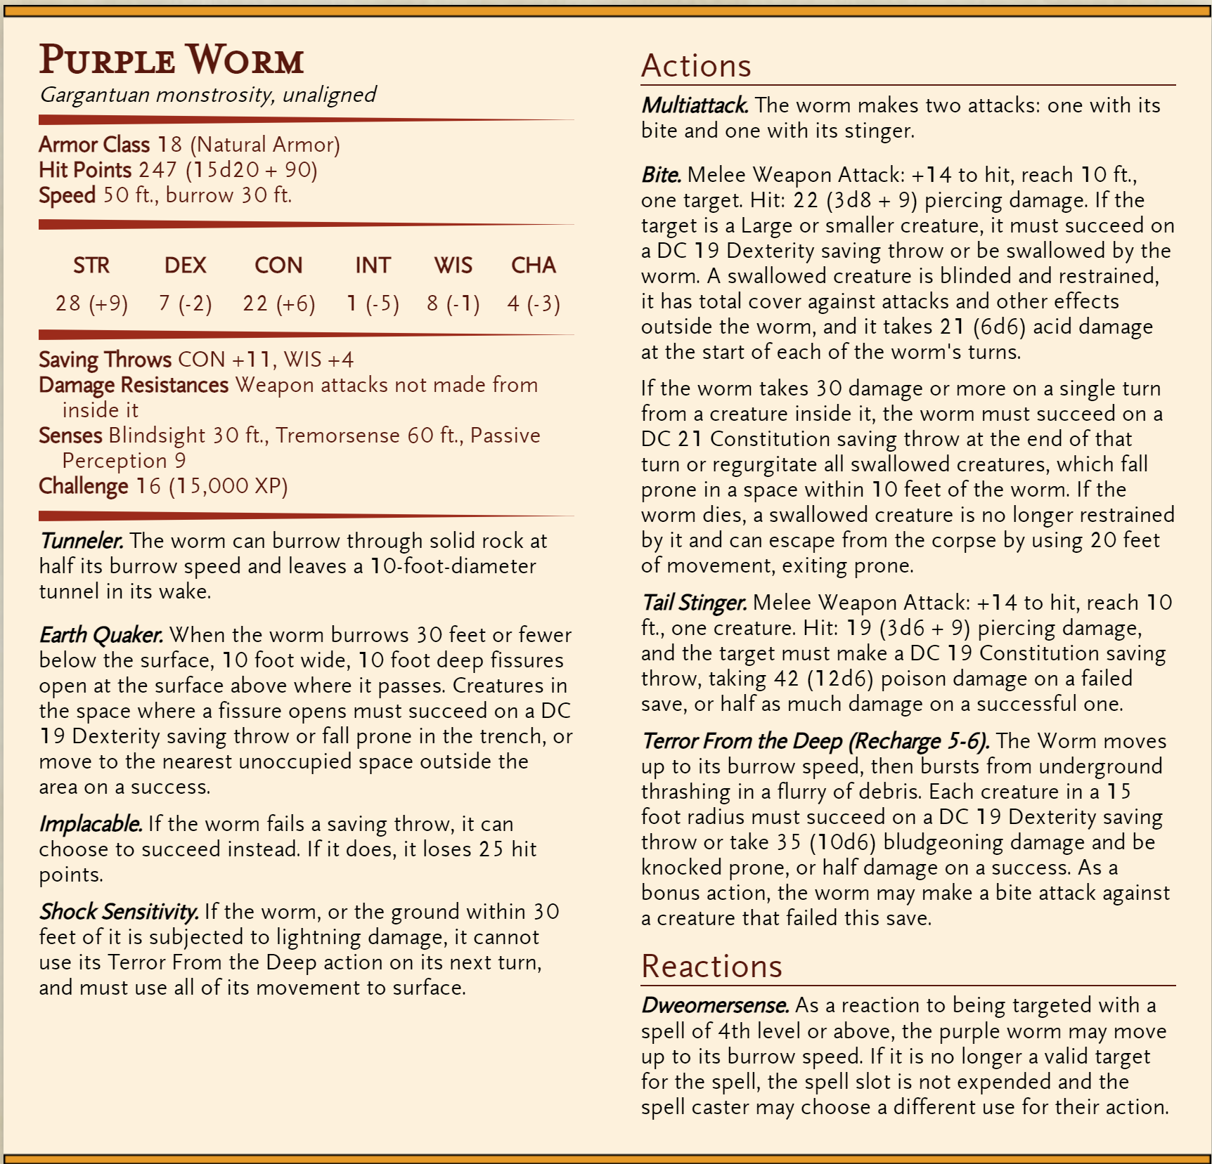
Muldvarp
Notes:
https://homebrewery.naturalcrit.com/share/159ov2pshLjrDRt3nPA6f3l6uVsqe4QA7PuQrQ1F6DuBz

Slide 6
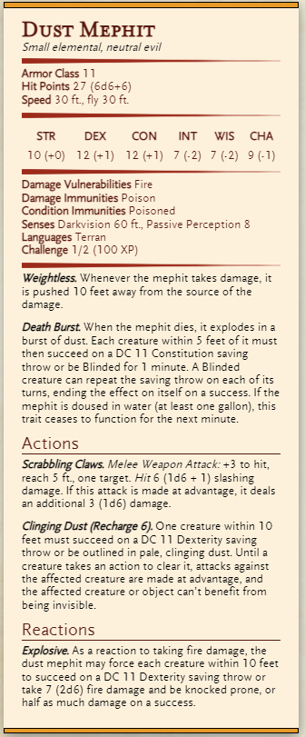
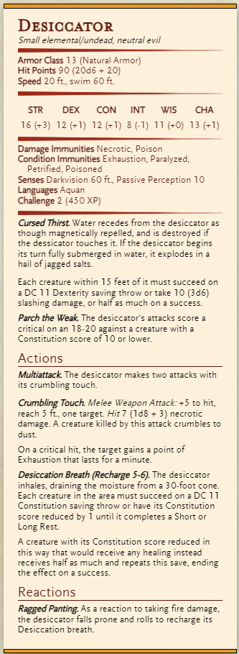
Forsker Medium
Climb
Ren Svamp
Medium
30
Notes:
Cancer Svamp, Elemental/Plant

